Slide 1
bitConnect - CompostConnect
Brief Synopsis
Compost Connect is a platform for Connecting Compost processed from City Wet Waste with Farmers and Corporate Land Bank Owners using Technology. Thereby creating a cleaner, safer environment and chemical free farms.
Team Details
Sridhar Babu Kolapalli.
Naveen Garla.

Slide 2
Problem being solved
Help City Municipal corporations by efficiently managing wet waste
Increase efficiency of Garbage processing centers significantly
Reliable and predictable source of compost for organic farming
Healthier Soil – Retain nutrients longer, reduces leaching
Reduce Pesticide ill Effects on peoples Health
Contribute to Swachh Bharat by reducing garbage dump yards/Land Fills and green house effects

Slide 3
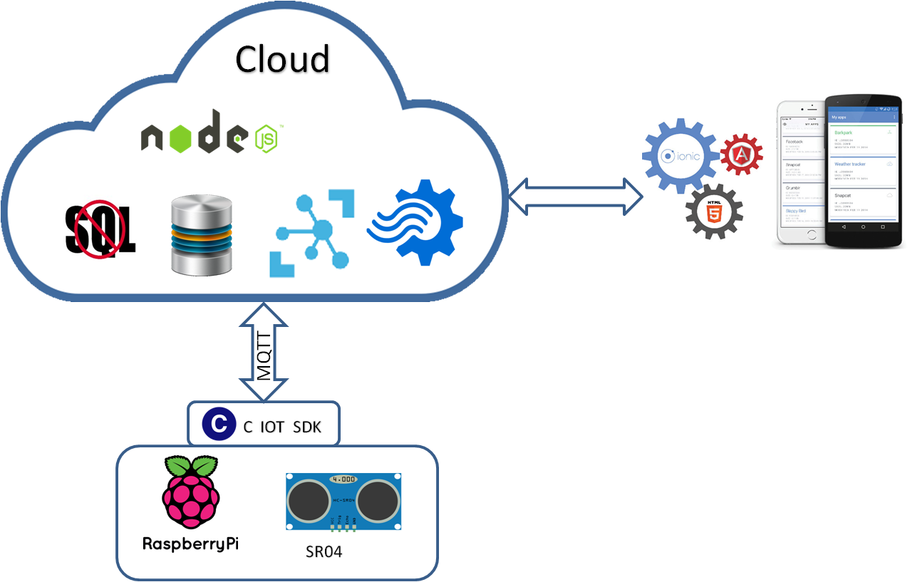
Technology Stack
A micro controller - Raspberry Pi 2
UltraSonic sensor to calculate distance + C SDK
IoT Hub for event data ingestion
Stream Analytics on-the fly decisions
Hybrid Mobile App built using Node js, Ionic js
NoSql for telemetry
SQL for command center / master data/inventory
Notes:
- Raspberry Pi (Even a small micro controller would do)
- UltraSound sensor to calculate distance
- c sdk for IoT Hub (MQTT tcp:8883)
- IoT Hub for event data ingestion
- Stream Analytics for temporal analytics & on-the fly decisions
- Node js
- Ionic for Hybrid Mobile App
- NoSql for telemetry
- SQL for command center / master data/inventory

Slide 4
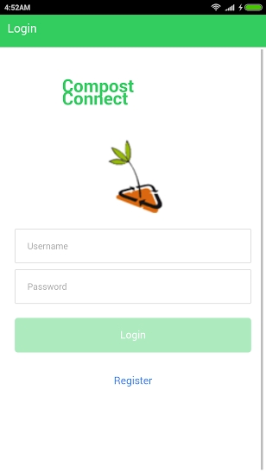
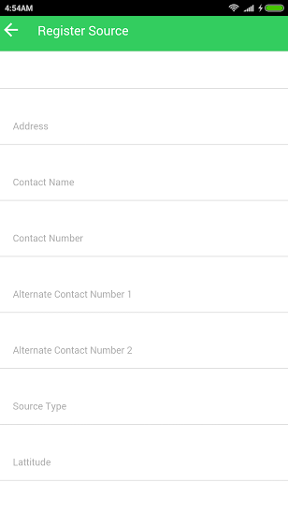
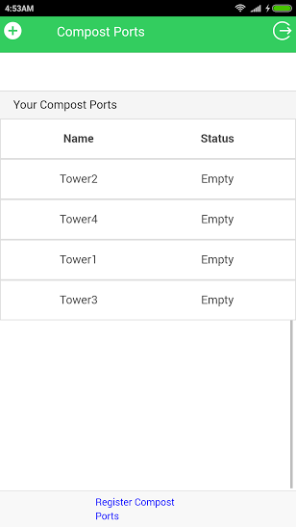
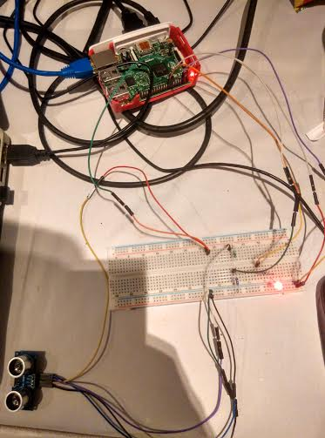
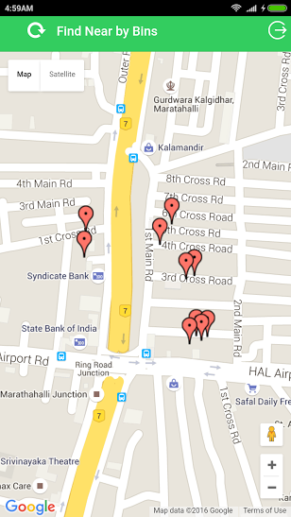
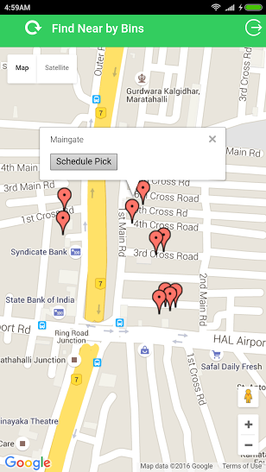
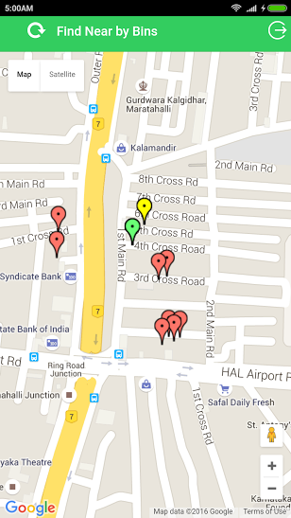
Demo Video/Screenshots

Slide 5
Challenges faced
Cloud Communication from Pi - Unstable Python SDK (community contributed) based on Paho, switched to core C SDK
Cloud to Device Messaging - Thread sync issues, implemented callback approach
Sensor level calibration and calculations
Mobile to MQTT Broker Communication - Fixed via HTTPS relay endpoint

Slide 6
Future Scope
Work with Local Corporation / NGOs for feasibility
Work with Central/State Govt - Farmer help line integration
Command Center Portal/Billing Portal
Amazon Dash Button Integration for Farmers

